Slide 1
Determining the priorities of trainers professional development based on the analysis of assessment results in the framework of professional development courses
Ilyassova M.
Astana, 2022

Slide 2
Professional development
Professional development is an important factor in improving the quality of education
Dunn, R., Hattie, J., & Bowles, T. (2019)
Professional development change the teaching practices of teachers and can positively affect achievement and learning of the students
Hilda Borko (2004)

Slide 3
Research methodology
Determining the priorities of trainers’ professional development was based on the principles of andragogy.
The assessment results of the mathematics and computer science teachers’ presentation (80 groups) were selected as a sample.
A statistical analysis of the assessment results of teachers' presentations was carried out.
A qualitative analysis of the assessment results was carried out.
The survey data obtained by the Likert method are considered.

Slide 4
Assessment results
Assessment | Goals |  |  | Teaching methods |  |  | Tasks
 | the learning objectives correspond to the curriculum | the lesson objectives correspond to the learning objectives | the objectives of the lesson are formulated in the SMART format in accordance with the level of development of thinking skills | contribute to the achievement of learning goals | promote the involvement of all students in the learning process | support the training of students in accordance with individual and special needs | meet the assessment criteria and levels of thinking skills | contribute to the development of functional literacy | meet the individual and special educational needs of students
2 mark | 97,4% | 88,7% | 25,4% | 60,8% | 48,1% | 22,0% | 35,8% | 28,1% | 18,7%
1 mark | 1,2% | 9,1% | 70,5% | 33,9% | 48,2% | 72,3% | 61,2% | 66,8% | 75,9%
0 mark | 1,3% | 2,2% | 4,0% | 5,3% | 3,7% | 5,7% | 3,0% | 5,2% | 5,4%
Teachers of mathematics, 1195 presentations

Slide 5
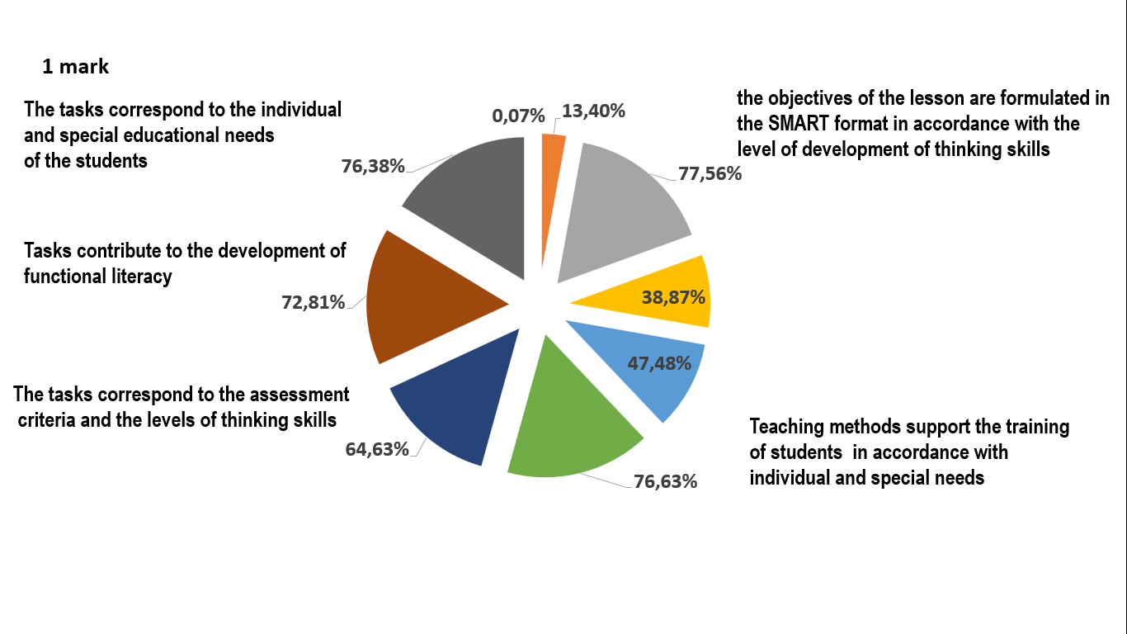
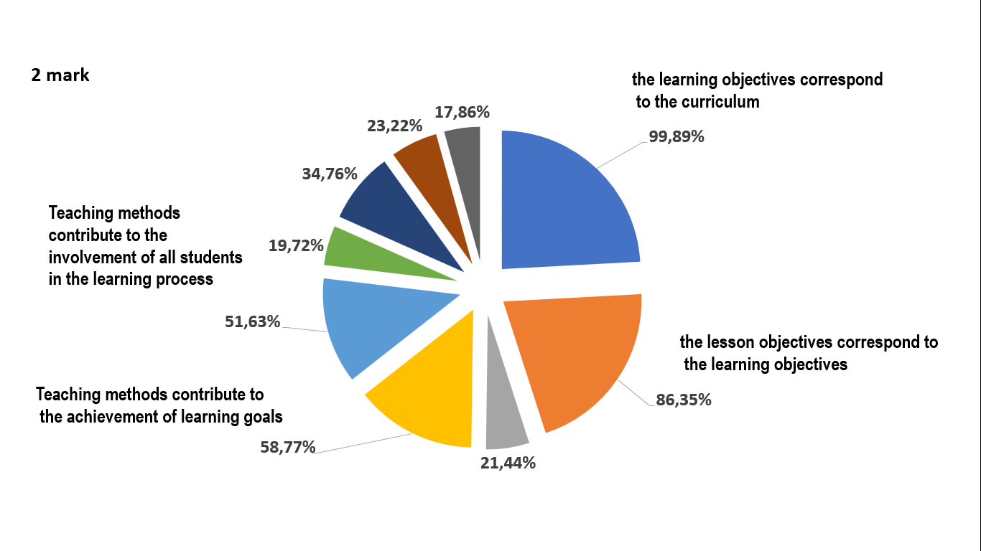
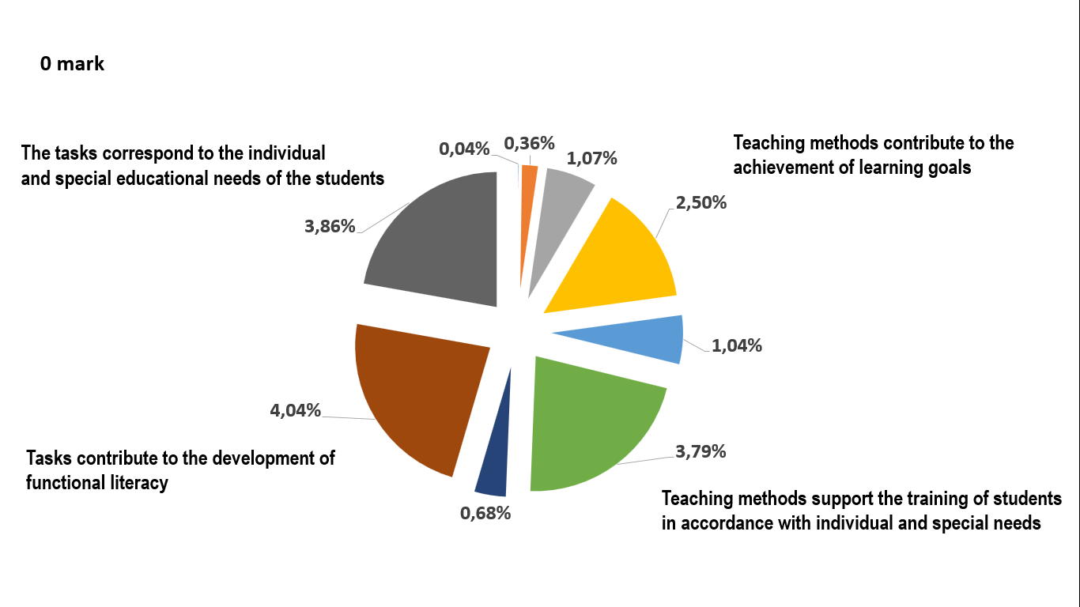
Assessment results of the presentation of mathematics and computer science teachers

Slide 6
Assessment results by groups
Of the 80 groups, 43% have presentations in which the decision was made to «Fail»;
Of these, the assessment results of 9 groups show a low indicator.

Slide 7
Assessment results
Assessment | Goals |  |  | Teaching methods |  |  | Tasks
 | the learning objectives correspond to the curriculum | the lesson objectives correspond to the learning objectives | the objectives of the lesson are formulated in the SMART format in accordance with the level of development of thinking skills | contribute to the achievement of learning goals | promote the involvement of all students in the learning process | support the training of students in accordance with individual and special needs | meet the assessment criteria and levels of thinking skills | contribute to the development of functional literacy | meet the individual and special educational needs of students
2 mark | 99% | 60% | 8% | 18% | 29% | 6% | 22% | 4% | 6%
1 mark | 1% | 35% | 83% | 62% | 66% | 65% | 72% | 66% | 65%
0 mark | 1% | 5% | 10% | 19% | 5% | 29% | 6% | 30% | 29%
The results of the evaluation of groups in the context of criteria that showed low results

Slide 8
Qualitative analysis of the assessment and questionnaire results. Conclusions.
1. The average age of teachers is 30-40 years. 2. Each group has an average of 4-6 teachers: - select teaching methods that contribute to the achievement of the lesson goal; - tasks are being developed that contribute to the development of functional literacy.
Lesson plan: -80% of the plan does not take into account the needs of students; - teachers of the same group choose the same teaching methods; - the tasks are standard, not developed by the teacher himself.
I completely agree: - development of skills of using students' experience as the basis of learning-52%; - development of skills in organizing the educational process taking into account the needs of students-43%
I completely agree: - development of skills of using students' experience as the basis of learning-52%; - development of skills in organizing the educational process taking into account the needs of students-43%
Priorities of professional development of trainers:
development of tasks that contribute to the development of functional literacy;
using teachers' experience in teaching;
training tailored to the needs of teachers.

